Slide 1

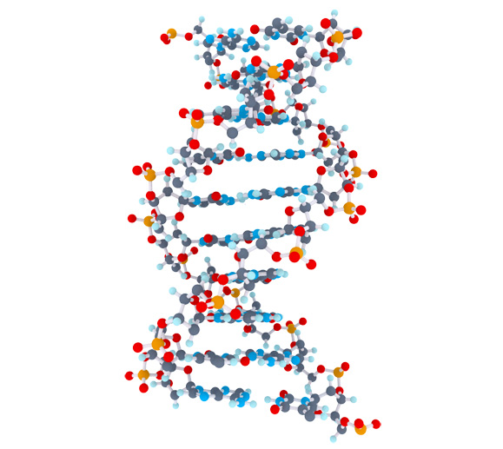
Celiac Disease Triggers
1
Matthijs Knigge

Slide 2
Overview
2
Project goal
Mendelian Randomization
Methods
Data
Pipeline
Preliminary results
Future steps

Slide 3
Project Goal
3
Inspect > 70.000 clinical parameters and molecular mechanisms to;
Find identification of factors that cause or protect against Celiac Disease
Quantify the impact of causal or protective factors

Slide 4



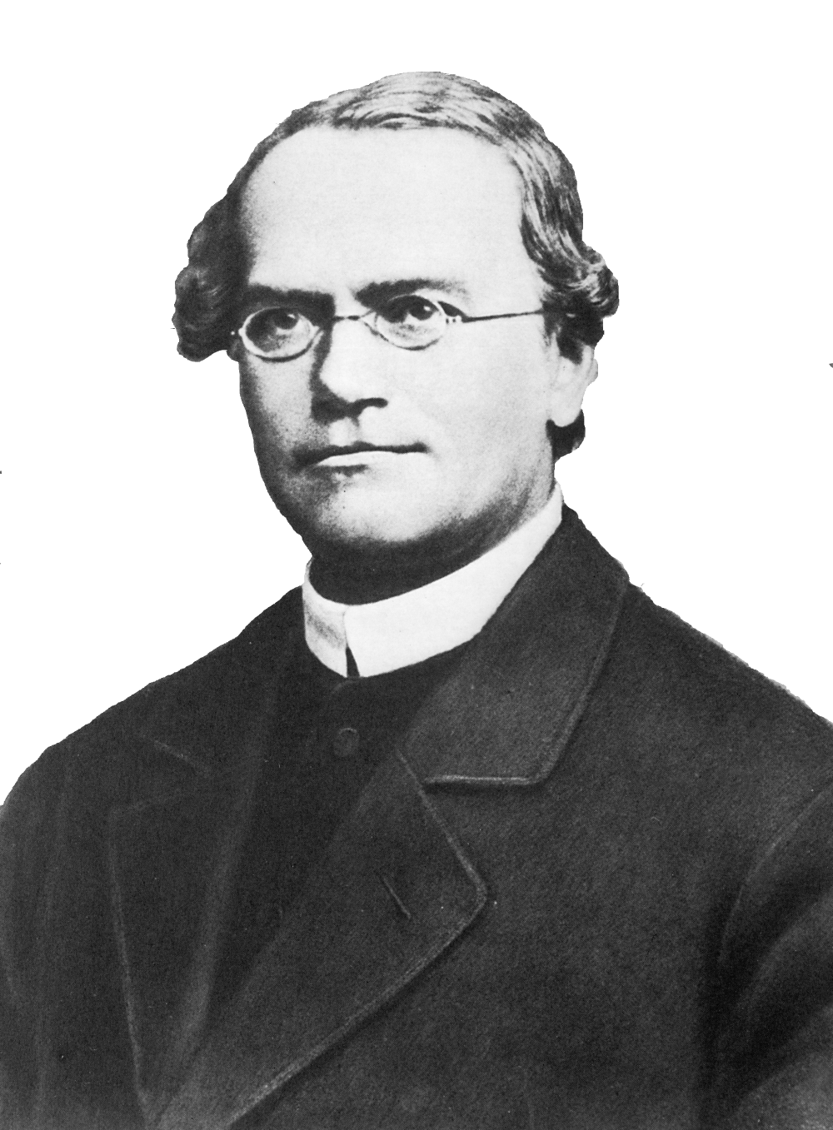










Mendelian Randomization (MR)
Randomized Controlled Trials (RCT)
4
Sample
Random assignment of subjects
Sample
Random allocation of alleles
Case
Control
Genotype
AA
Genotype
aa
Target effects
Protein effects
Outcome

Slide 5


Mendelian Randomization setup
5
SNP
Exposure phenotype
Outcome phenotype
Confounders
Rules that need to be met before using a genetic variant in the MR framework
The genetic variant must be associated with the exposure of interest
The genetic variant must not be associated with confounders
The genetic variant may only affect the outcome through the exposure

Slide 6



Methods
6
Two-Sample MR | - Estimate causal effect between different samples - Summary-level data from GWAS can be used | - Cannot test for confounding - No overall causal estimate - Assumes genetic variants are uncorrelated (not in linkage disequilibrium) | - Causal estimate between genetic variants
Inverse-Variance Weighted method (IVW) | - Overall causal estimate between exposure and outcome - Summary-level data from GWAS can be used | - Assumes causal estimates provide independent evidence (no correlation) - Cannot test for confounding | - Overall causal estimate between exposure and outcome
MR-egger method | - Can be deployed when the core assumptions do not hold. - Can test for confounding (correlation between variants) - Can test for a causal effect - An estimate of the overall causal effect | - Needs 3 or more genetic variants - Assumes genetic variants are uncorrelated - Cannot distinguish between pleiotropy and a causal effect when genetic variants almost have equal estimates | - Overall causal estimate - MR-egger causal test - Overall pleiotropic effect
Bidirectional MR | - Can determine when genetic variant exhibits primary effect on the exposure, or the effect is secondary to the outcome | - difficulty in the presence of genetic variants that influence each other | - MR analysis in both directions, that ascertains direction of causal relationship

Slide 7
Data
7
 | Type | Amount of Phenotypes | Direction
Celiac, Trynka 2011 | GWAS Immunochip | 1 | Outcome
Celiac, Dubois 2010 | GWAS Immunochip | 1 | Outcome
The NHGRI-EBI GWAS catalog | Publicated GWAS | 2893 | Exposure
MRbase Metabolite | GWAS on metabolites in whole blood | 121 | Exposure
MRbase Proteins | GWAS on protein levels whole blood | 47 | Exposure
MRbase Gene Expression levels (GTEX) | GWAS on gene identifiers in 44 different tissues | 32432 | Exposure
MRbase Methylation levels | GWAS on methylation levels in whole blood across 5 time points | 33256 | Exposure
additional downloaded GWAS | GWAS | 1308 | Exposure
Total | 70059

Slide 8
Pipeline
8
SNP | effect_allele | beta | se | p
rs61733845 | T | 0.03536714 | 0.04432255 | 2.465e-06
rs1320571 | A | 0.01882175 | 0.04265126 | 6.590e-01
.... | .... | …. | …. | ….
GWAS
Celiac 2011. Gosia Trynka et al.
SNP | effect_allele | beta | se | p
rs314253 | C | -0.0201900 | 0.002646 | 2.471e-14
rs7775397 | G | -0.0369352 | 0.004845 | 2.721e-14
.... | …. | …. | …. | ….
GWAS
HDL, LDL, Triglycerides. Willer CJ et al. Discovery and refinement of loci associated with lipid levels. Nat. Genet. 2013. doi:10.1038/ng.2797
Outcome = Celiac Disease, Exposure = HDL, LDL, Triglycerides

Slide 9
Pipeline
9
Data input
Operation
GWAS exposure
Select genome-wide significance on exposure
First core assumption
Remove variants without Beta/Log odds on exposure
1000 Genomes
Query missing alleles by reference on exposure
GWAS outcome
Find overlap between exposure and outcome
Harmonize Exposure on Outcome
HLA region removed
- Positive align exposure
- Align outcome on exposure
- Remove palindromic SNPs

Slide 10


Data input
Operation
10
GWAS exposure
GWAS outcome
Clumping for proxy SNPs with PLINK
Second core assumption
Perform Wald-method
Perform Inverse-Variance Weighted method
Perform MR-egger method
Perform Cochran's Q test
Third core assumption
Perform Bidirectional MR
- Outcome becomes exposure
- Exposure becomes outcome
https://bitbucket.org/MatthijsKnigge/mendelianrandomization.git

Slide 11
Preliminary results
11
Total
Celiac 2011, Celiac 2010
Considerd FDR < .05 for MR-egger | IVW
Celiac 2011, Celiac 2010
483
63
Celiac 2011
Celiac 2011
434
21
Celiac 2010
Celiac 2010
567
36

Slide 12
Preliminary results
12
Celiac 2011, Gosia Trynka et al.
63 significant potential exposures
Top 10
Exposure | IVW | Egger | nSNP
Rheumatoid Arthritis | 3.171316e-06 | 4.627945e-15 | 53
eosinophils + basophils count | 1.361791e-05 | 8.413819e-08 | 28
eosinophils count | 1.482109e-07 | 2.594648e-06 | 32
lymphocytes count | 7.274596e-01 | 1.892860e-05 | 27
plateletcrit | 5.517519e-08 | 2.612460e-05 | 19
platelet count | 1.679860e-07 | 3.664932e-05 | 18
eosynophils percentage | 2.691746e-04 | 1.070842e-03 | 27
platelets distribution width | 8.302935e-03 | 1.199338e-03 | 14
hematocrit | 1.125320e-02 | 3.785512e-03 | 9
hemoglobin | 7.628868e-03 | 4.910752e-03 | 9

Slide 13
Preliminary results
13
Celiac 2010, Patrick Dubois et al.
36 significant potential exposures
Top 10
Exposure | IVW | Egger | nSNP
eosinophils count | 2.457824e-05 | 0.0344422831 | 25
hematocrit | 3.635149e-01 | 0.0344422831 | 22
neuthrophils percentage | 2.694008e-02 | 0.0344422831 | 25
eosinophils % granuloctyes | 6.095143e-03 | 0.0500008203 | 21
eosinophils + basophils count | 6.892643e-06 | 0.0545461874 | 24
eosynophils percentage | 3.581443e-03 | 0.0881148661 | 22
Type 1 Diabetes | 1.036351e-04 | 0.5464139213 | 24
Multiple Sclerosis | 2.899315e-02 | 0.5587373911 | 17
Packed cell volum | 4.829159e-02 | 0.5587373911 | 8
CD39+ Activated CD4 + CD8 - Treg % Parent | 4.356029e-02 | 0.5924281553 | 19

Slide 14
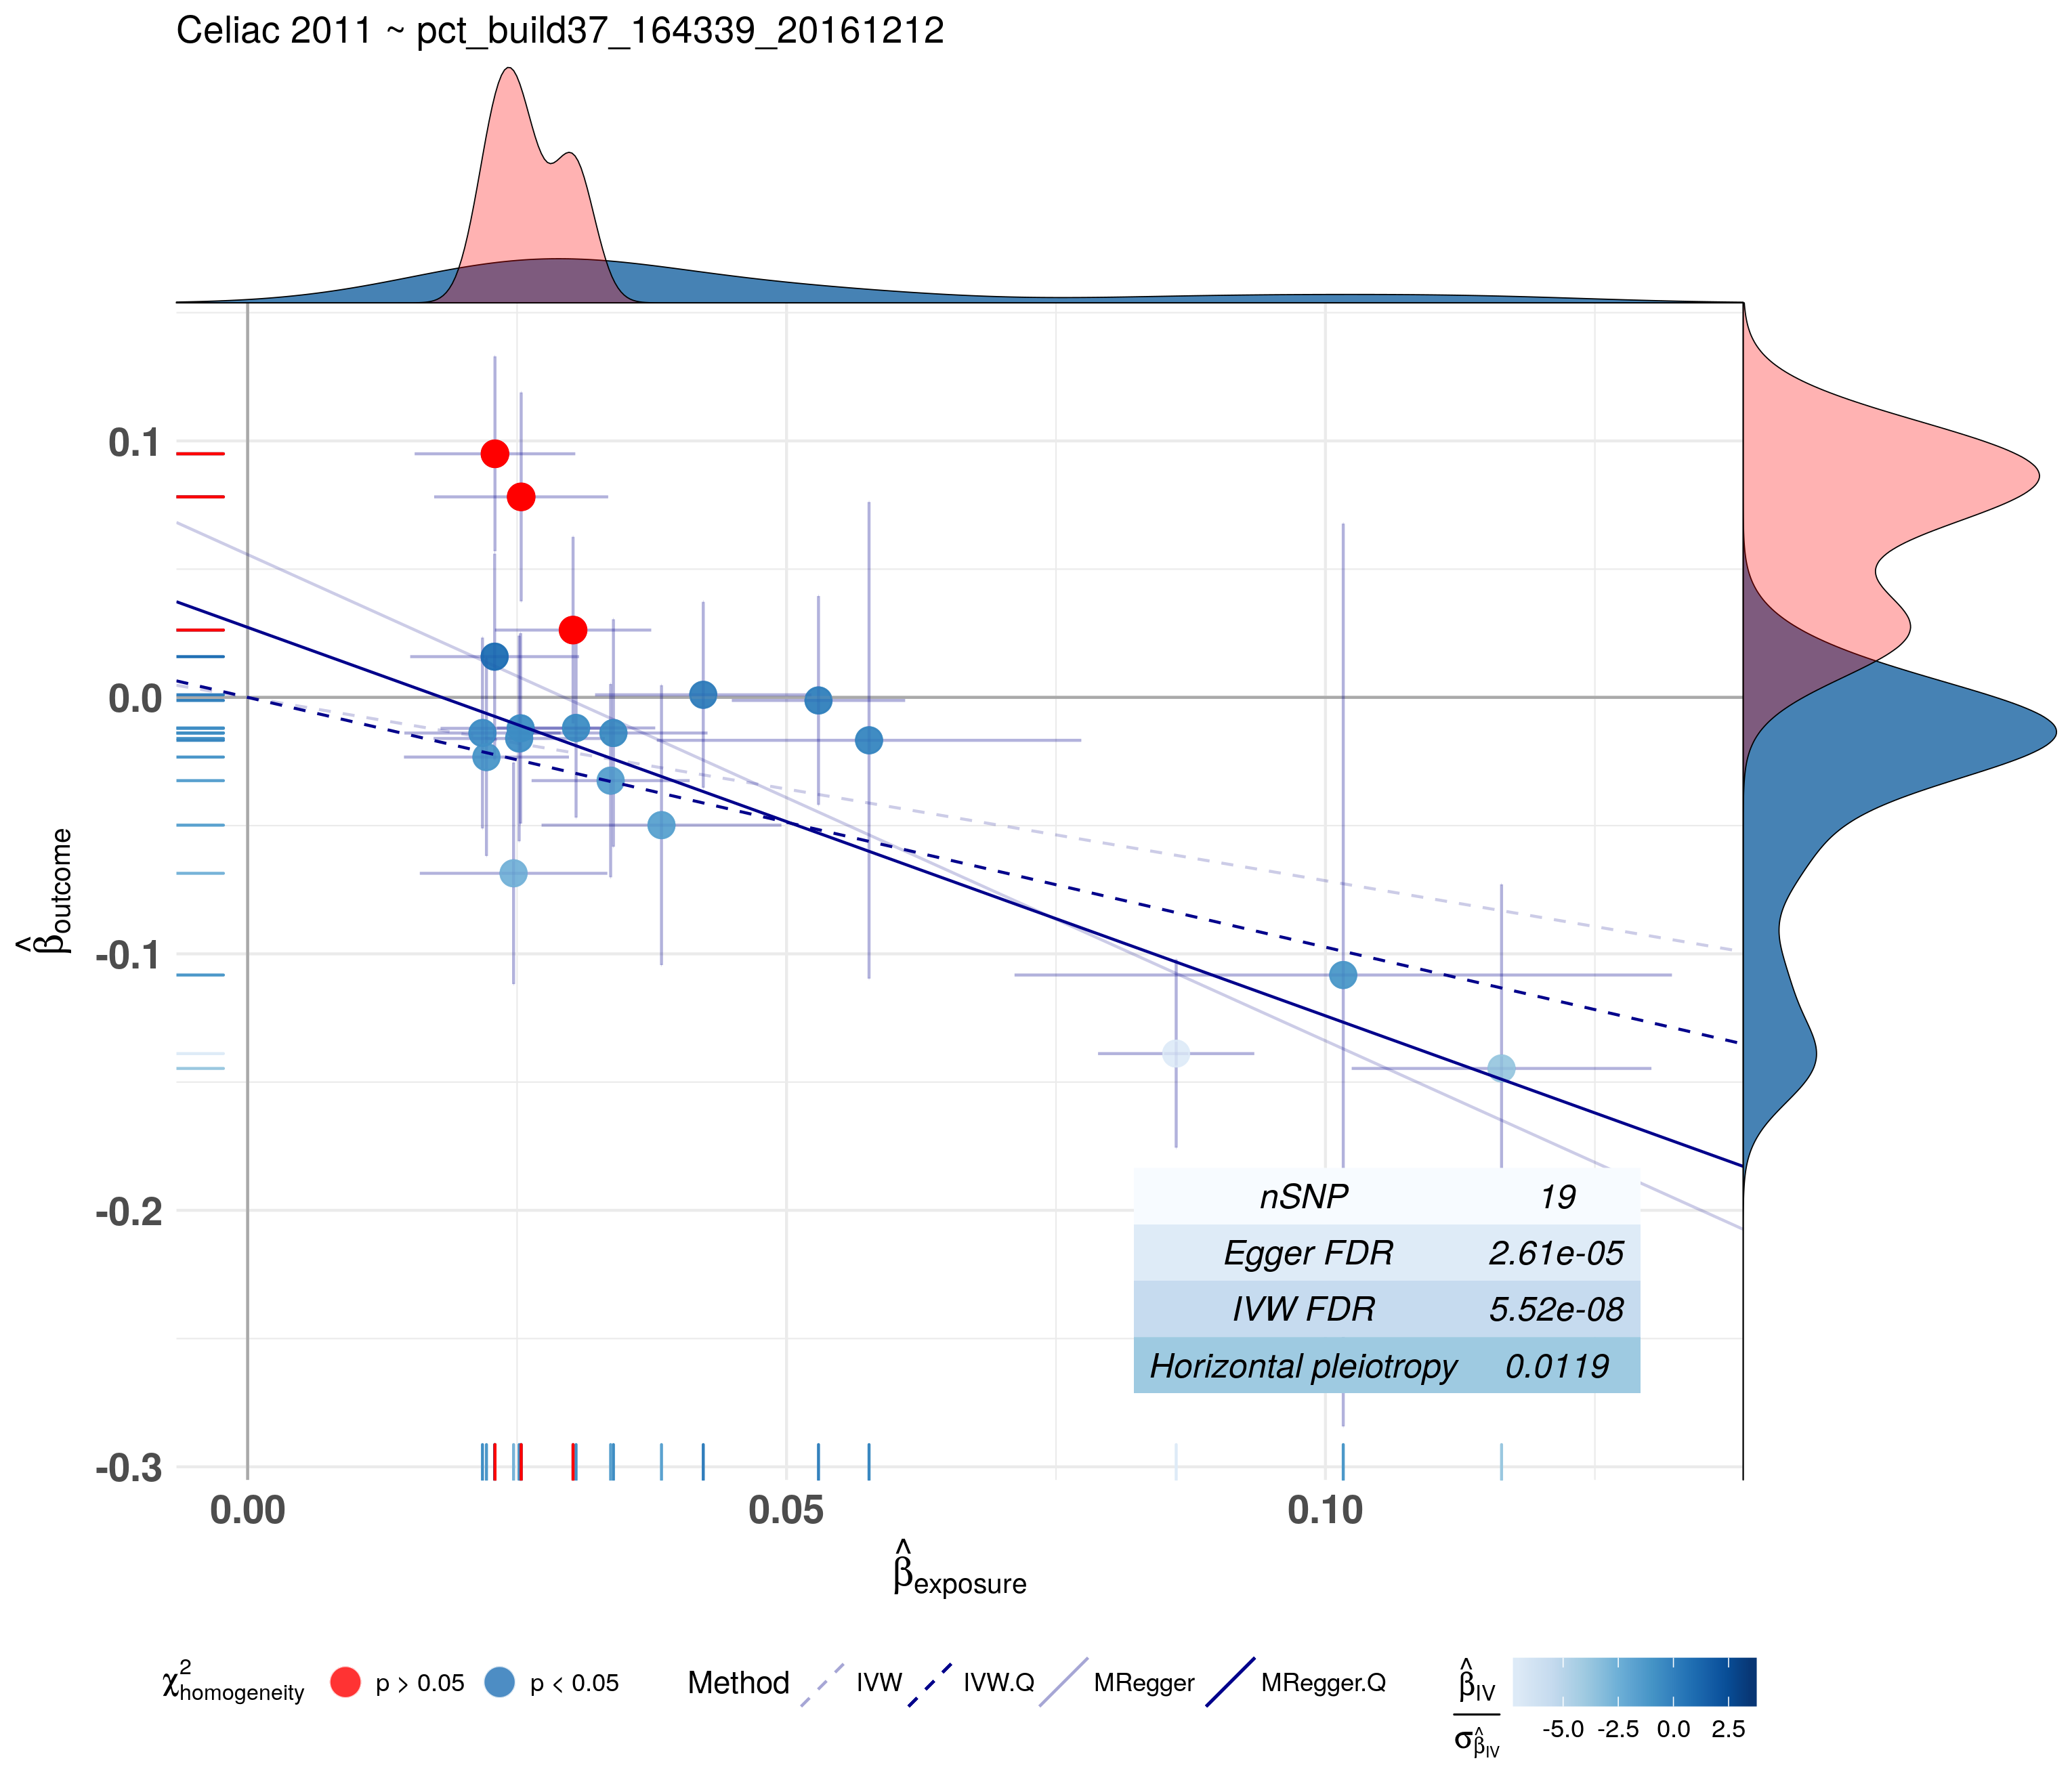
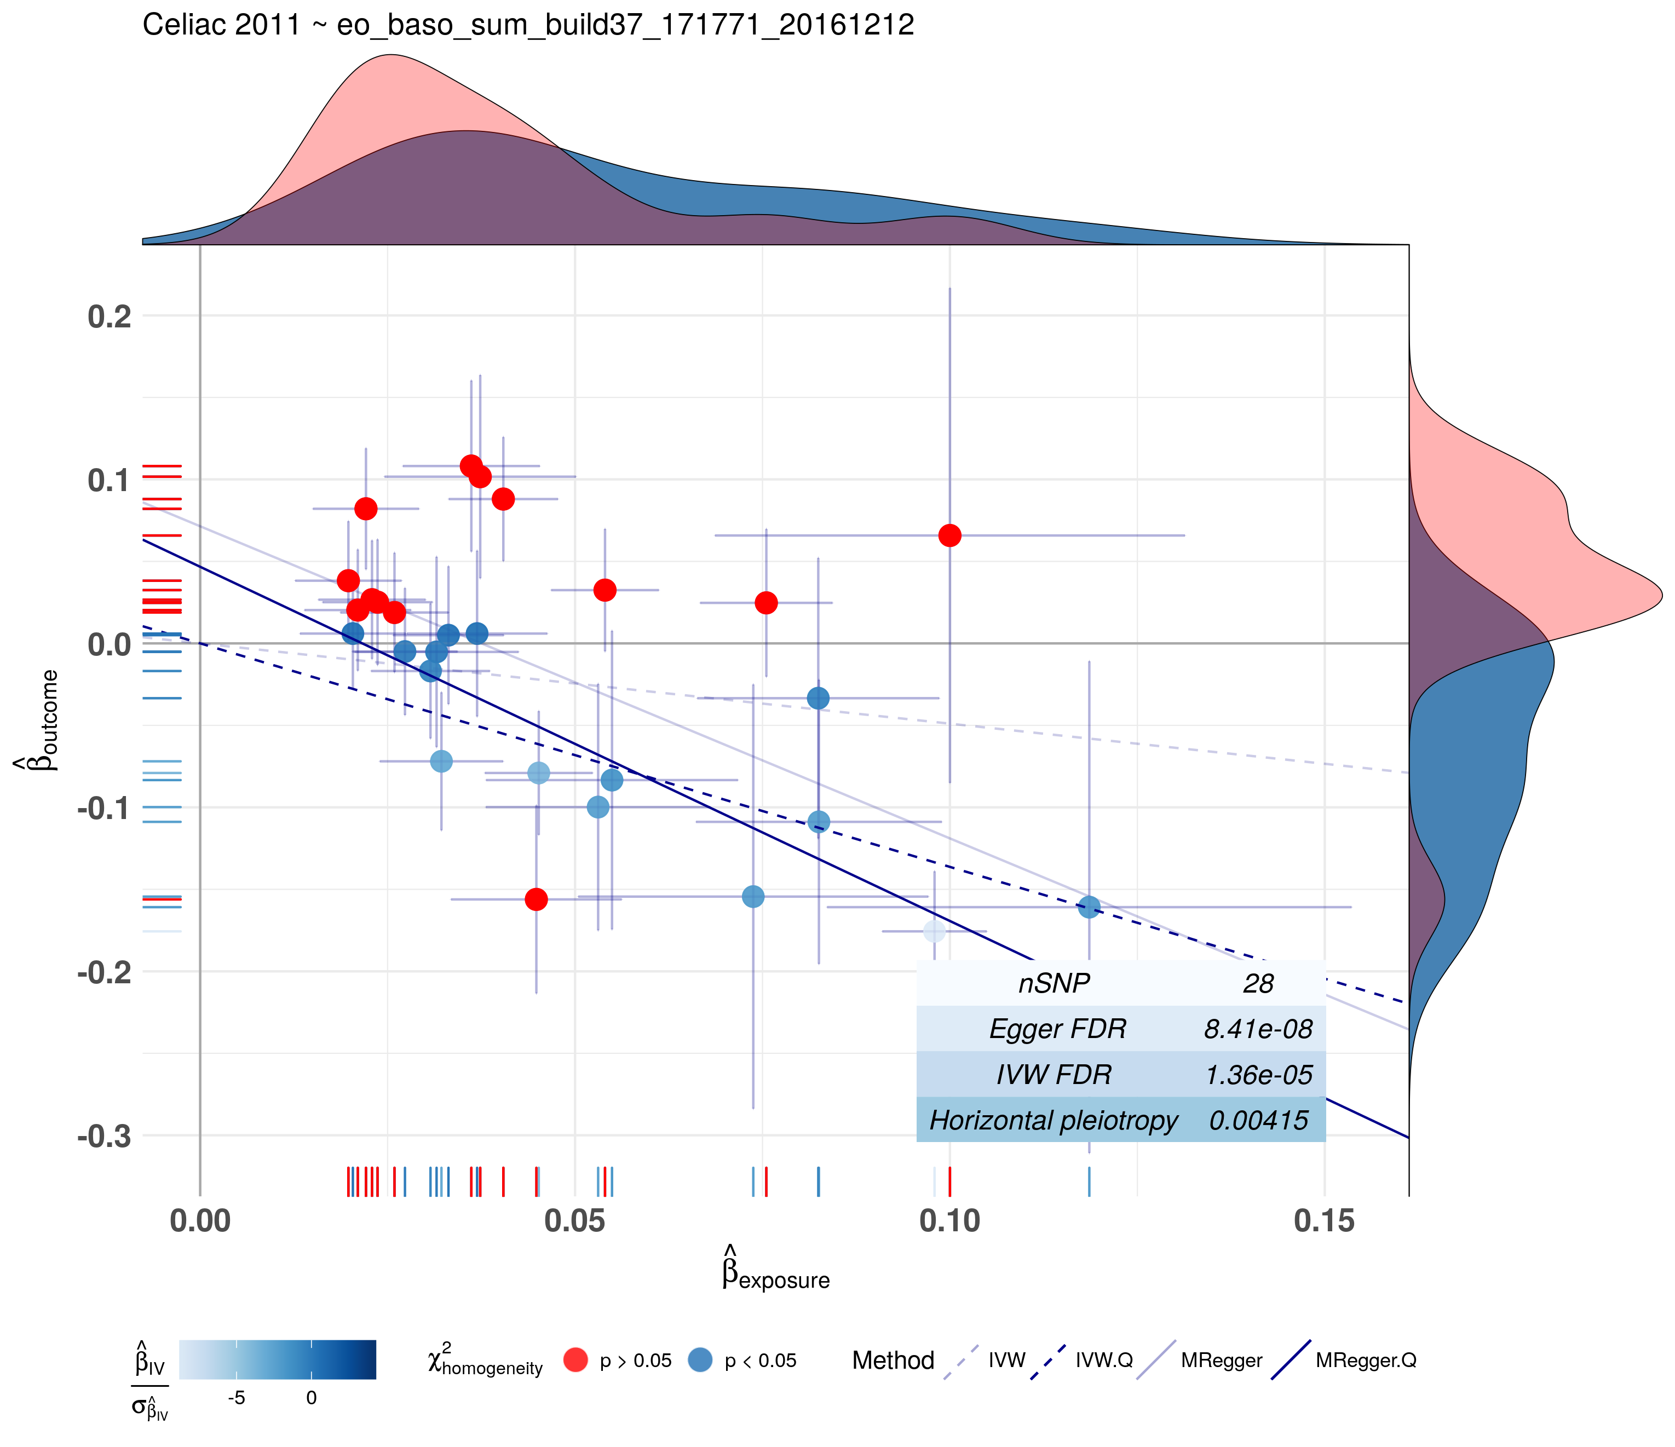
Preliminary results
14
Celiac 2011, Gosia Trynka et al.
An increase in 1 SD of platelecrit is responsible for an Odds ratio of
0.3356451 in celiac disease.
An increase in 1 SD of eosinophils + basophils count is responsible for an Odds ratio of 0.7140582 in celiac disease.

Slide 15
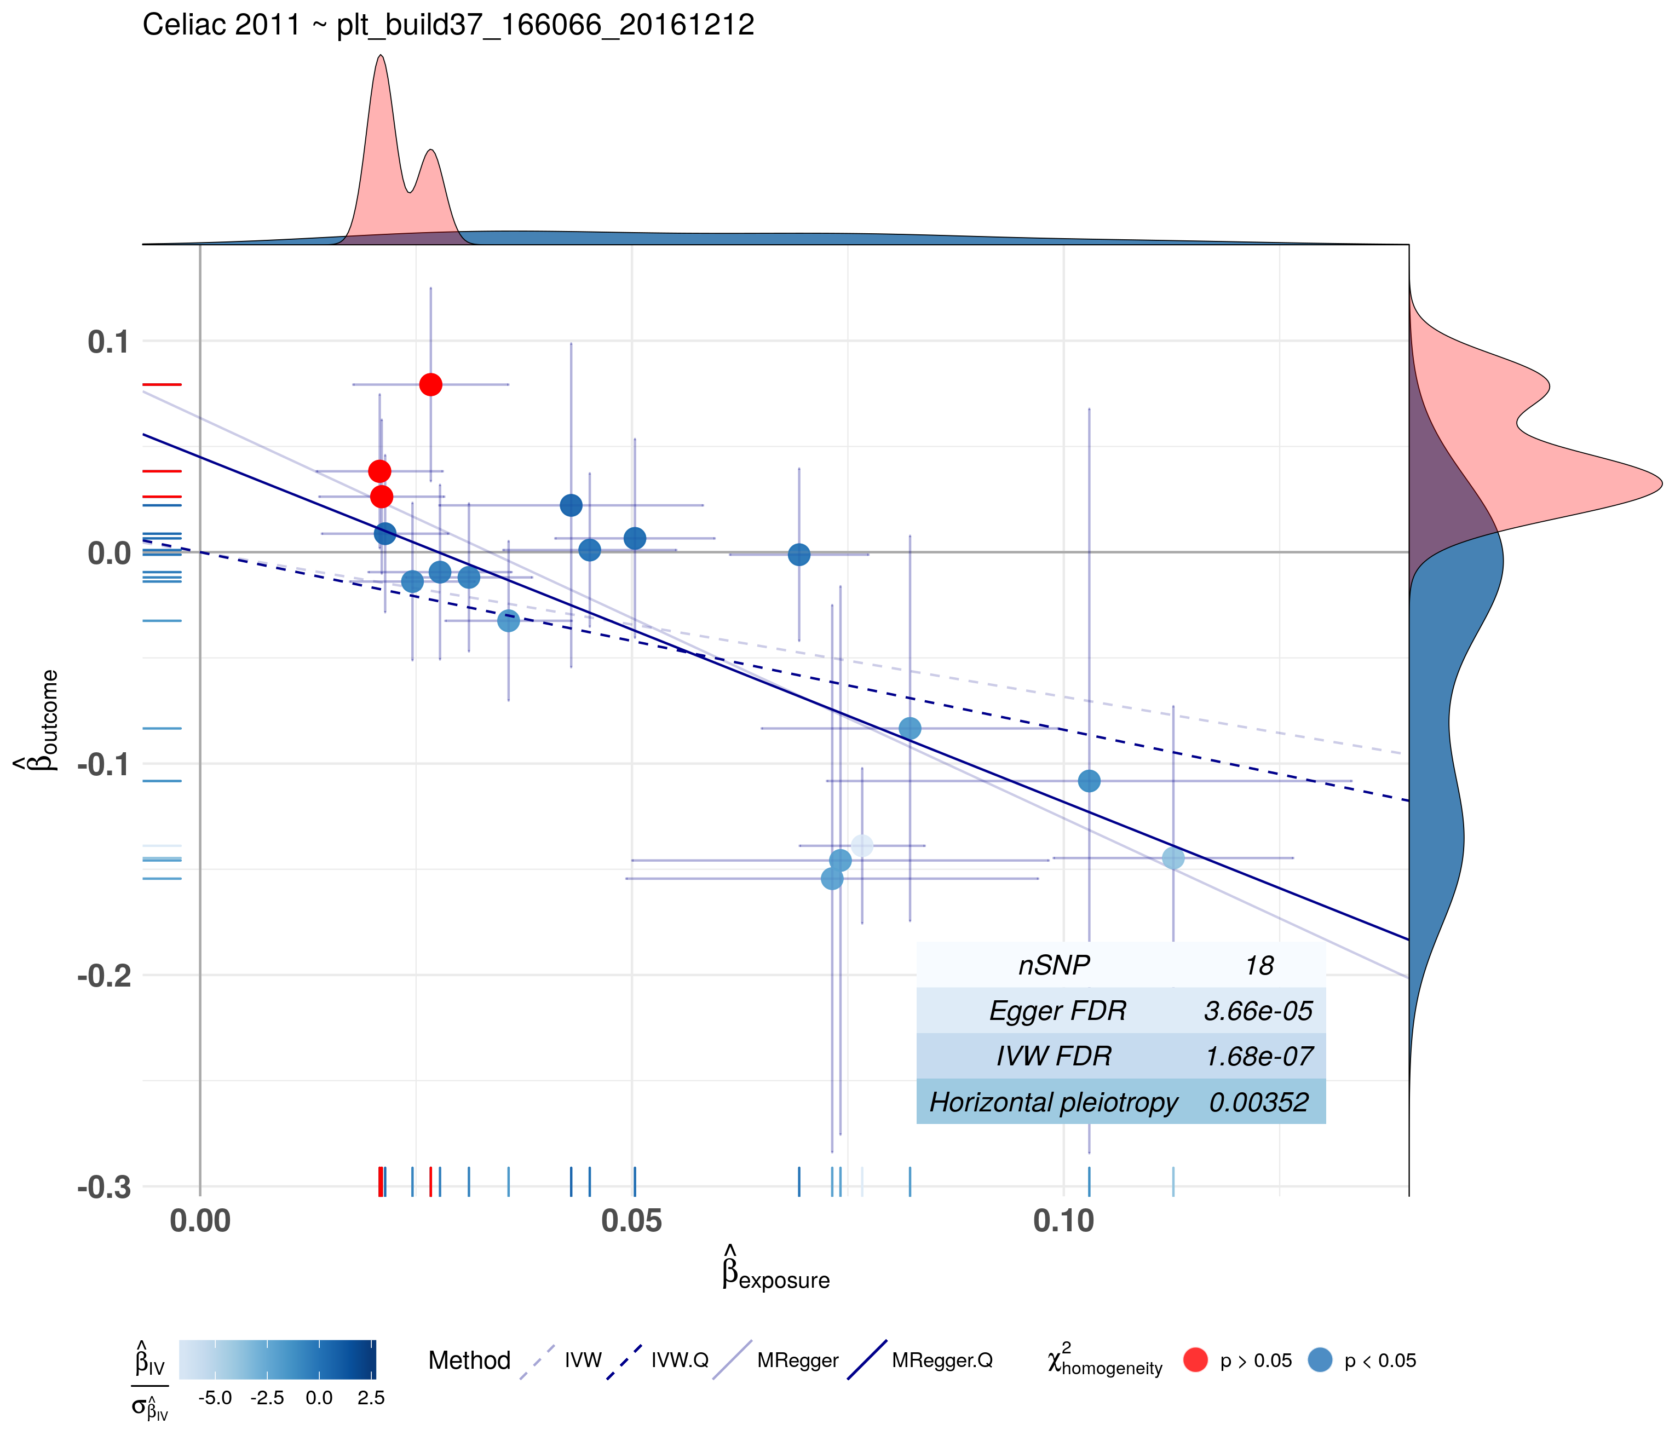
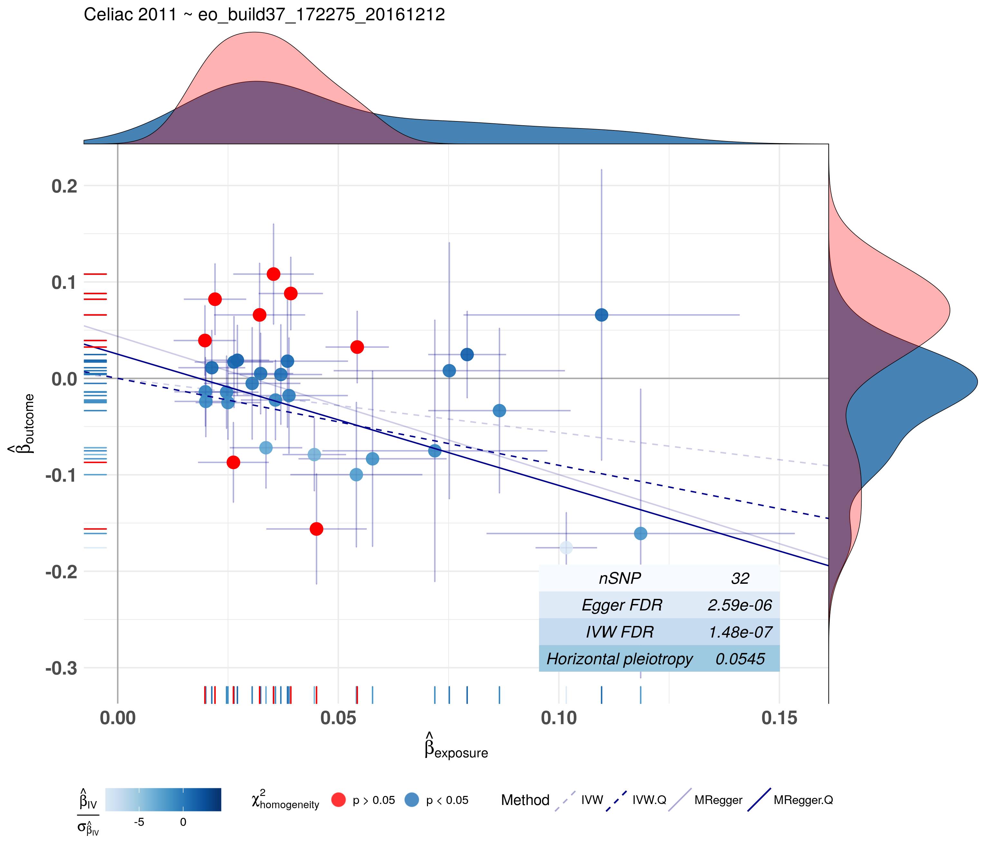
Preliminary results
15
Celiac 2011, Gosia Trynka, et al.
An increase in 1 SD of platelet count is responsible for an Odds ratio of 2.928006 in celiac disease.
An increase in 1 SD of eosinophils count is responsible for an Odds ratio of 0.5757044 in celiac disease.

Slide 16
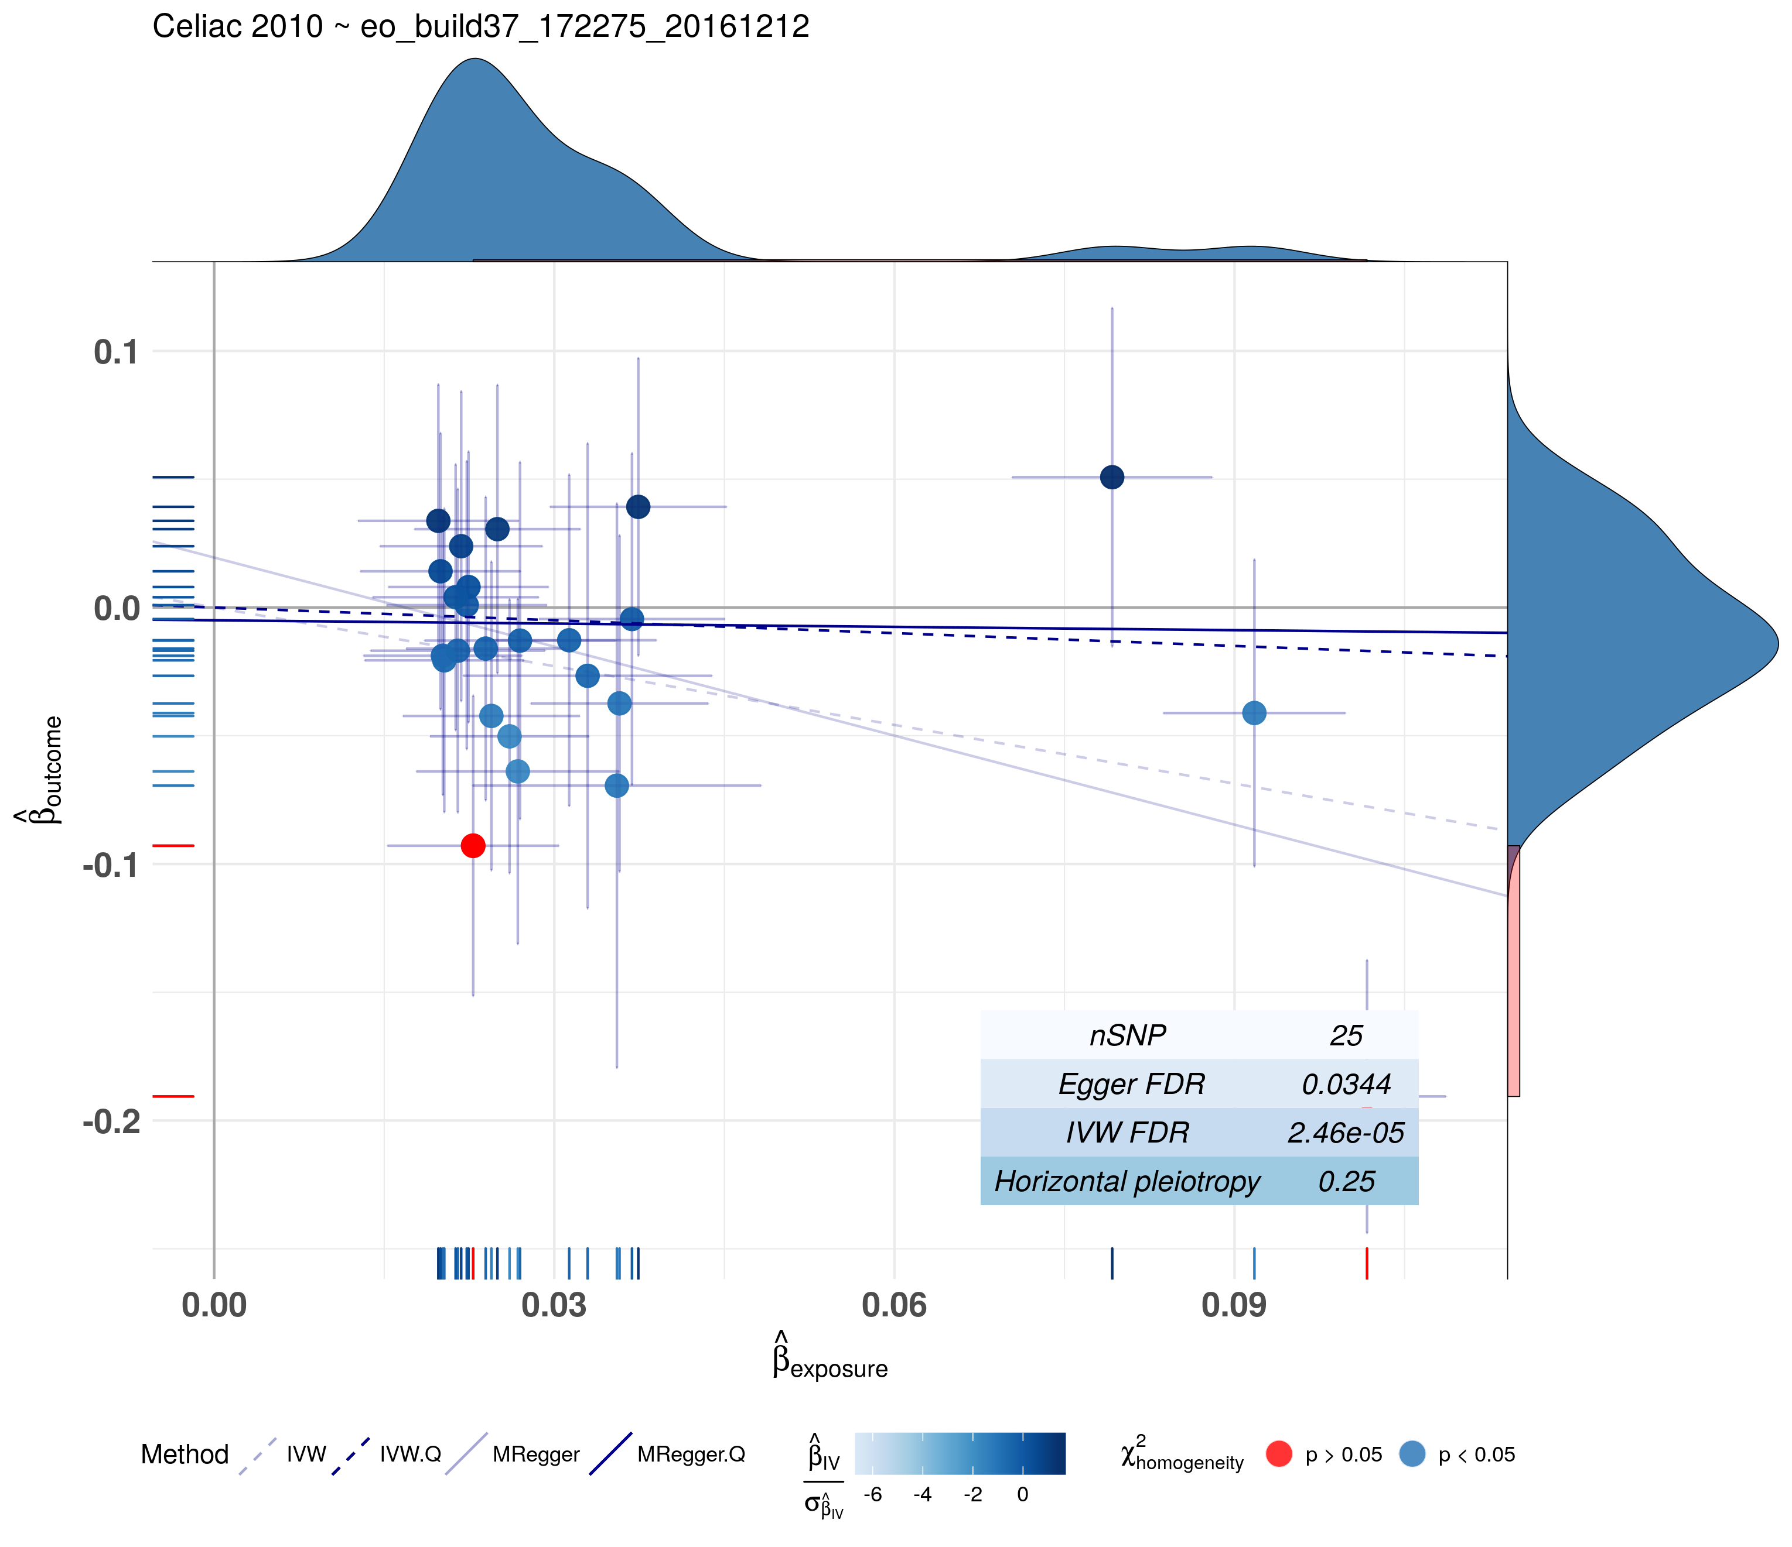
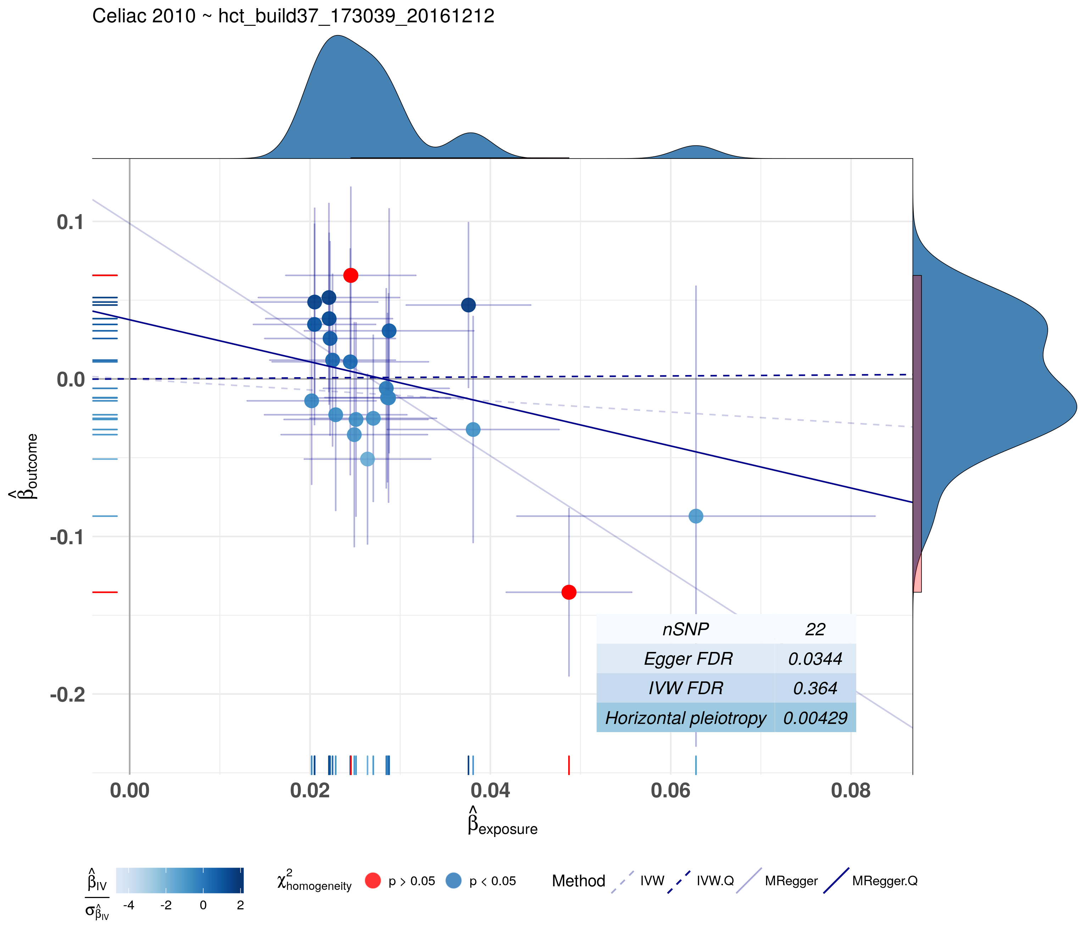
Preliminary results
16
Celiac 2010, Patrick Dubois et al.
An increase in 1 SD of eosinophils count is responsible for an Odds ratio of 0.2703218 in celiac disease.
An increase in 1 SD of hematocrit is responsible for an Odds ratio of 1.048042 in celiac disease.

Slide 17
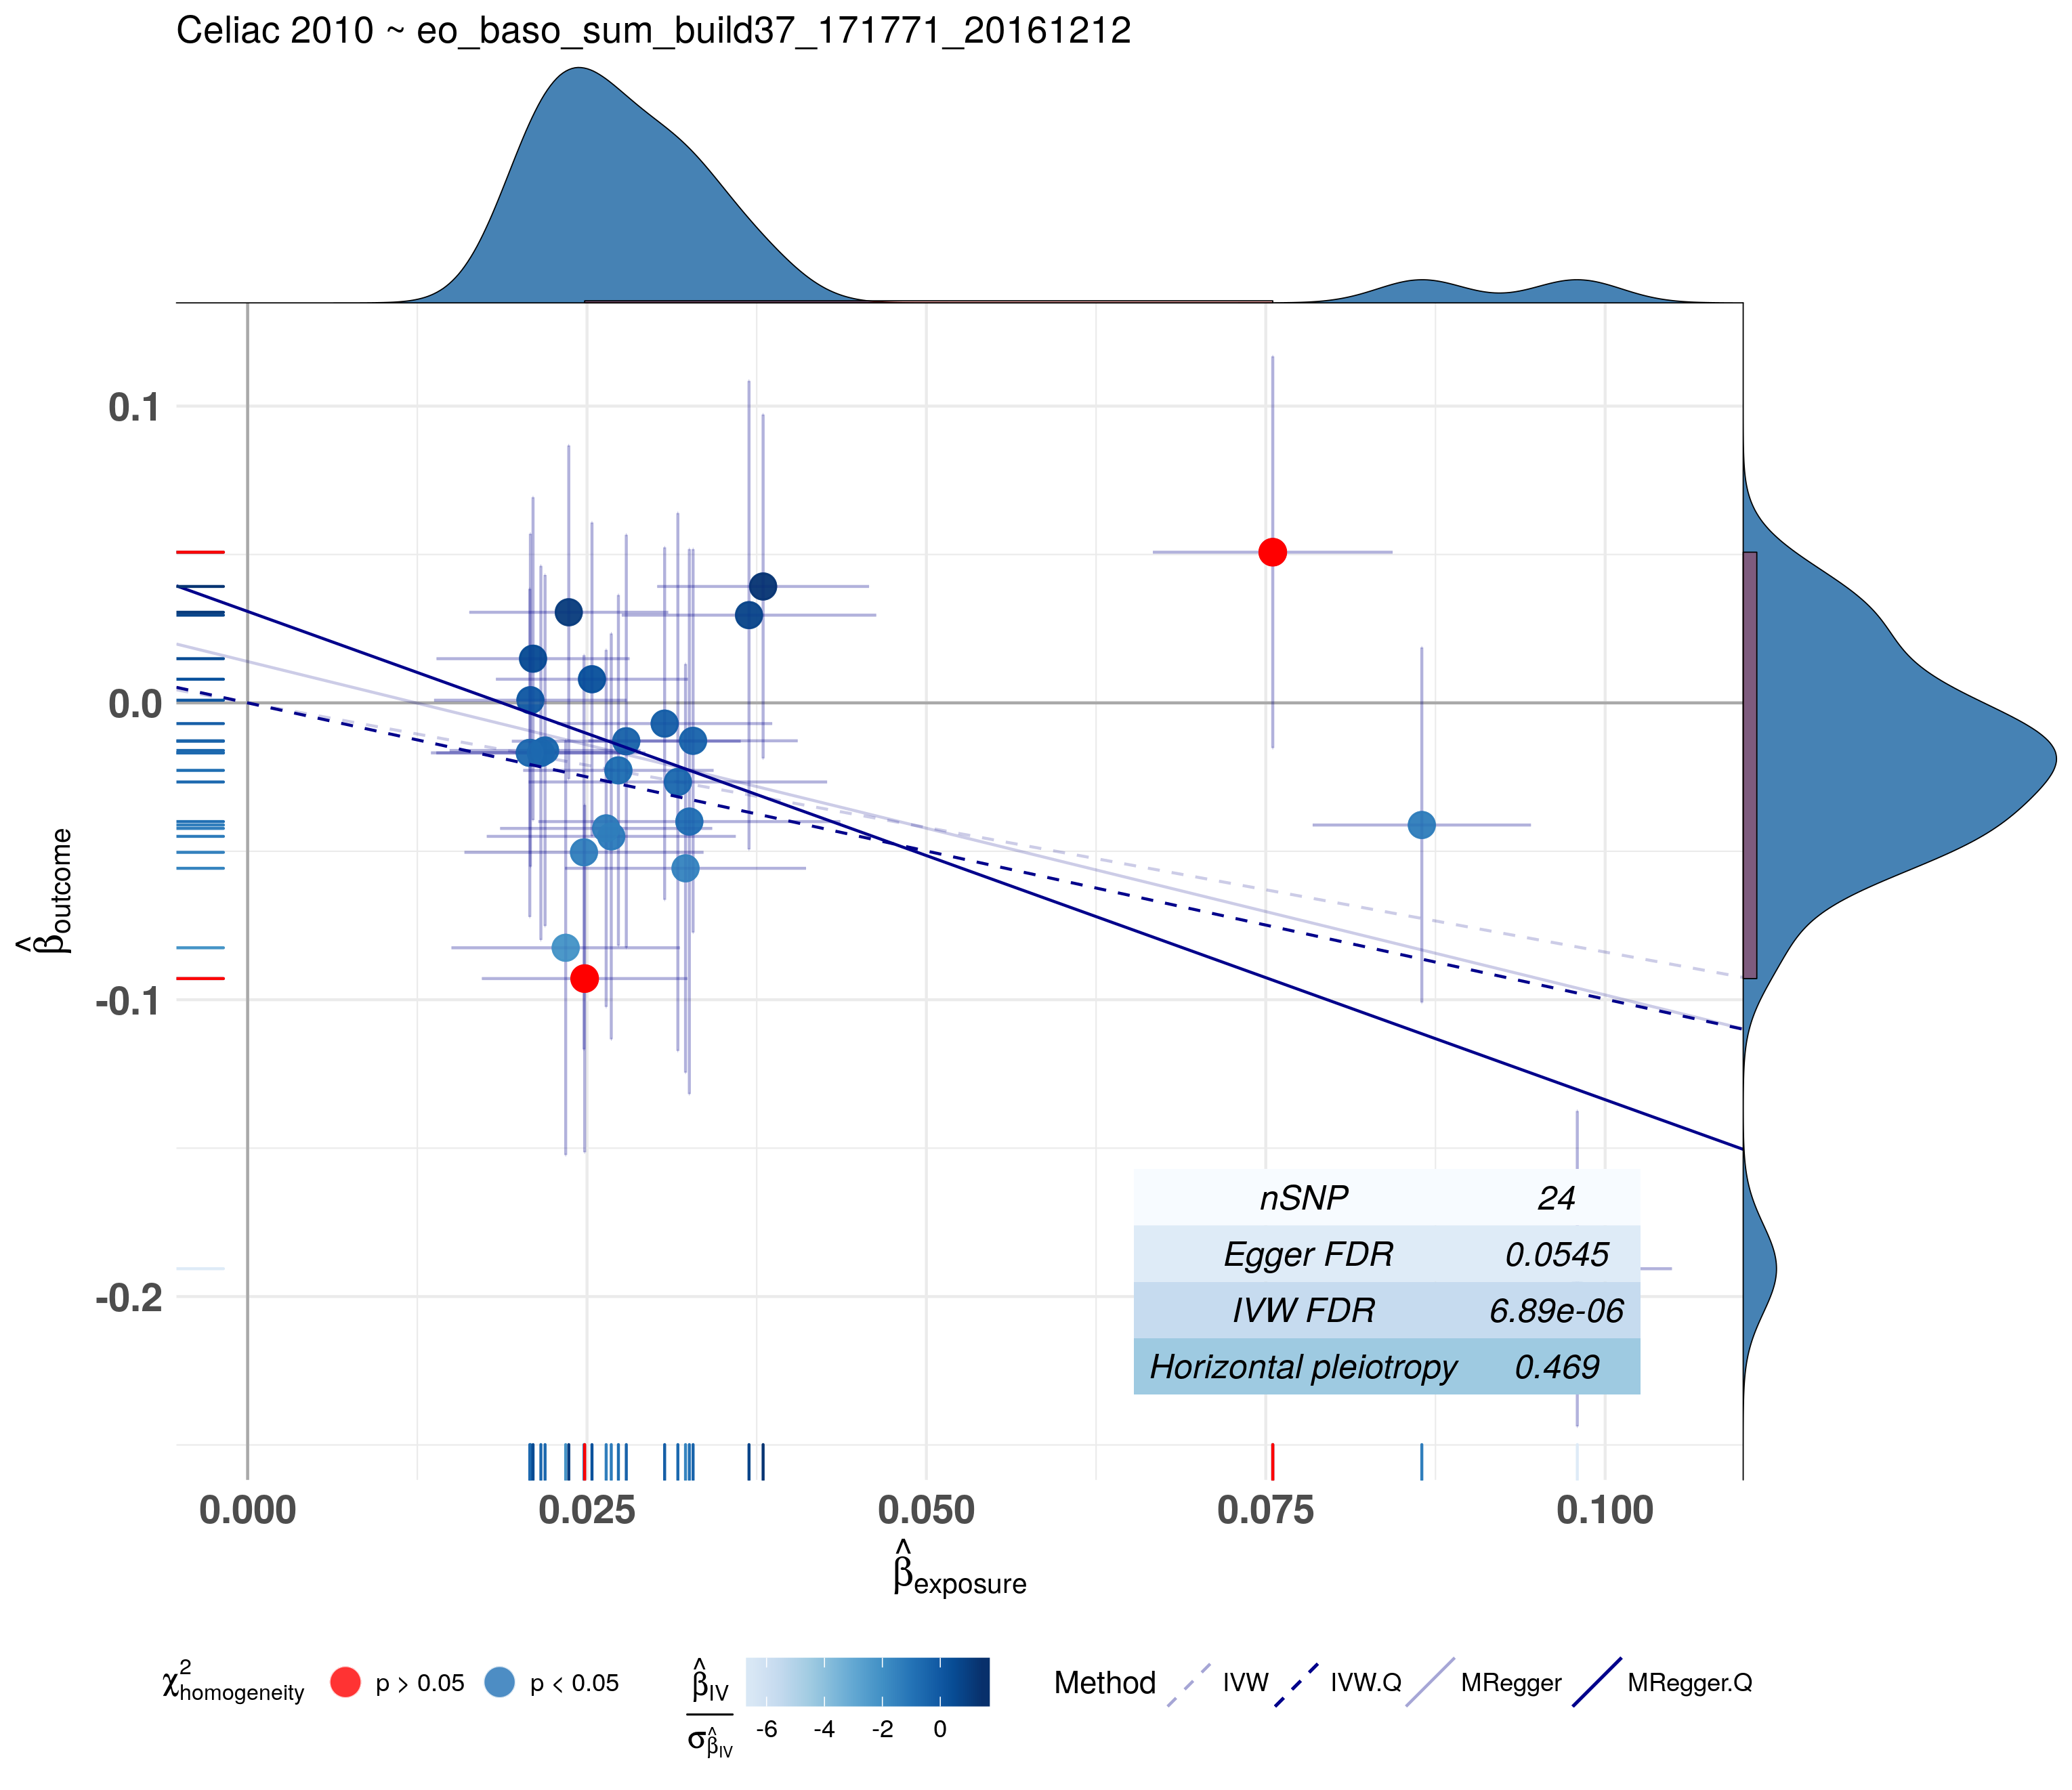
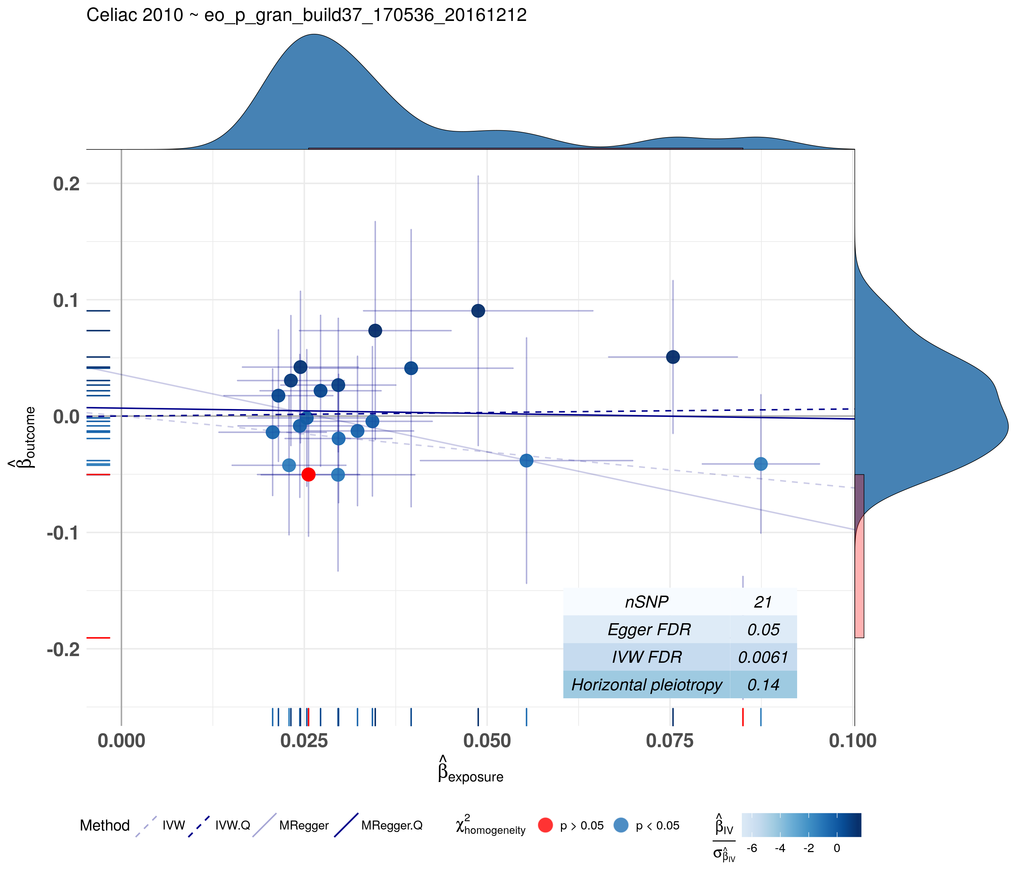
Preliminary results
17
Celiac 2010, Patrick Dubois et al.
An increase in 1 SD of eosinophils + basophils count
is responsible for an Odds ratio of 0.1749221 in celiac disease.
An increase in 1 SD of eosynophils percentage is responsible for an Odds ratio of 0.4843092 in celiac disease.

Slide 18
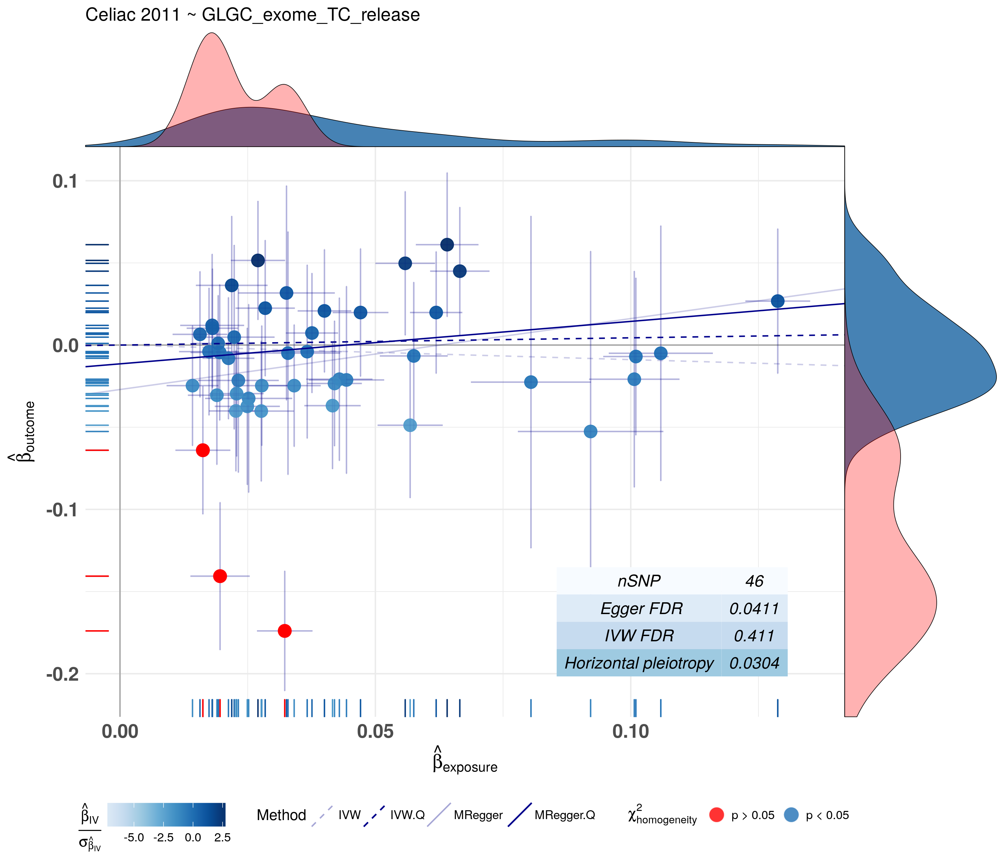
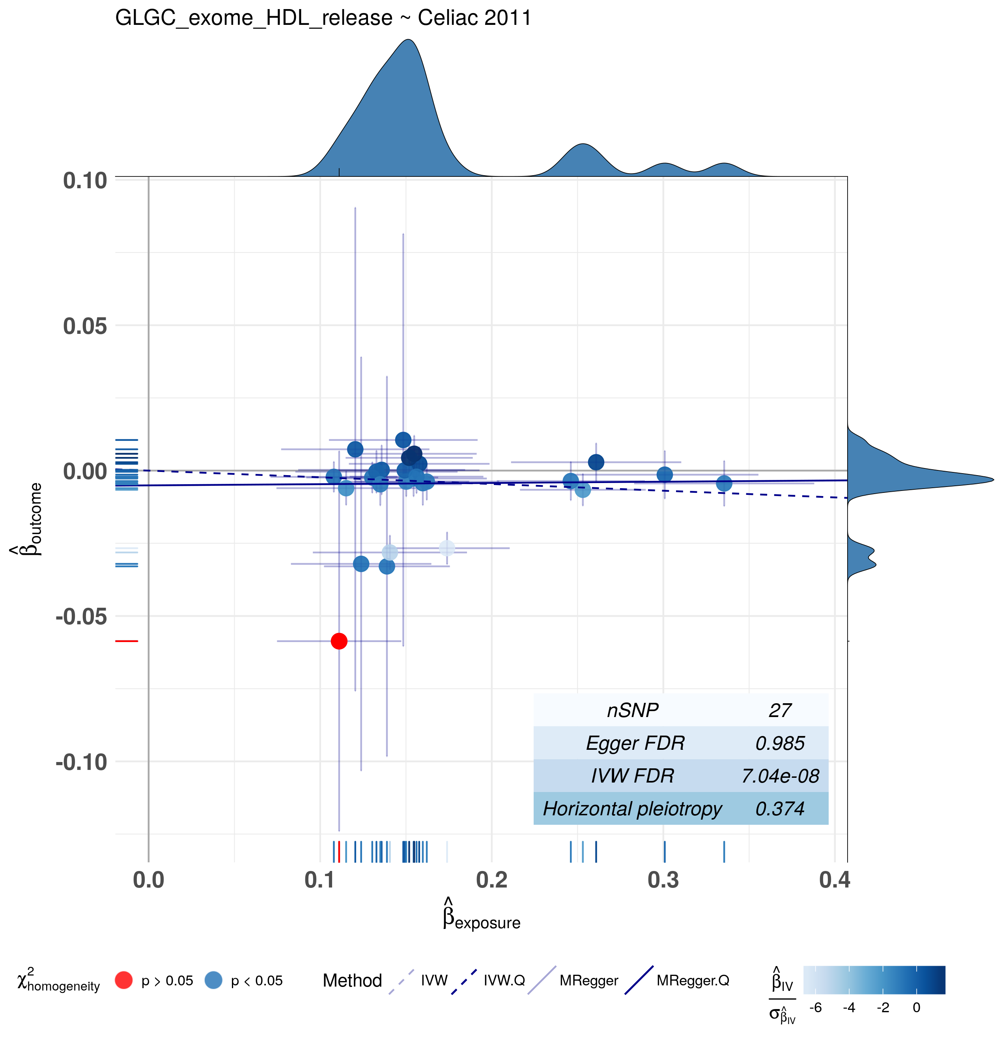
Preliminary results Bidirectional MR
18
Celiac 2011, Gosia Trynka et al.
An increase in 1 SD of LDL + HDL + Cholesterol is responsible for an Odds ratio of 2.423787 in celiac disease.
An increase in 1 SD of celiac is responsible for an Odds ratio of 3.545413 in LDL + HDL + Cholesterol

Slide 19
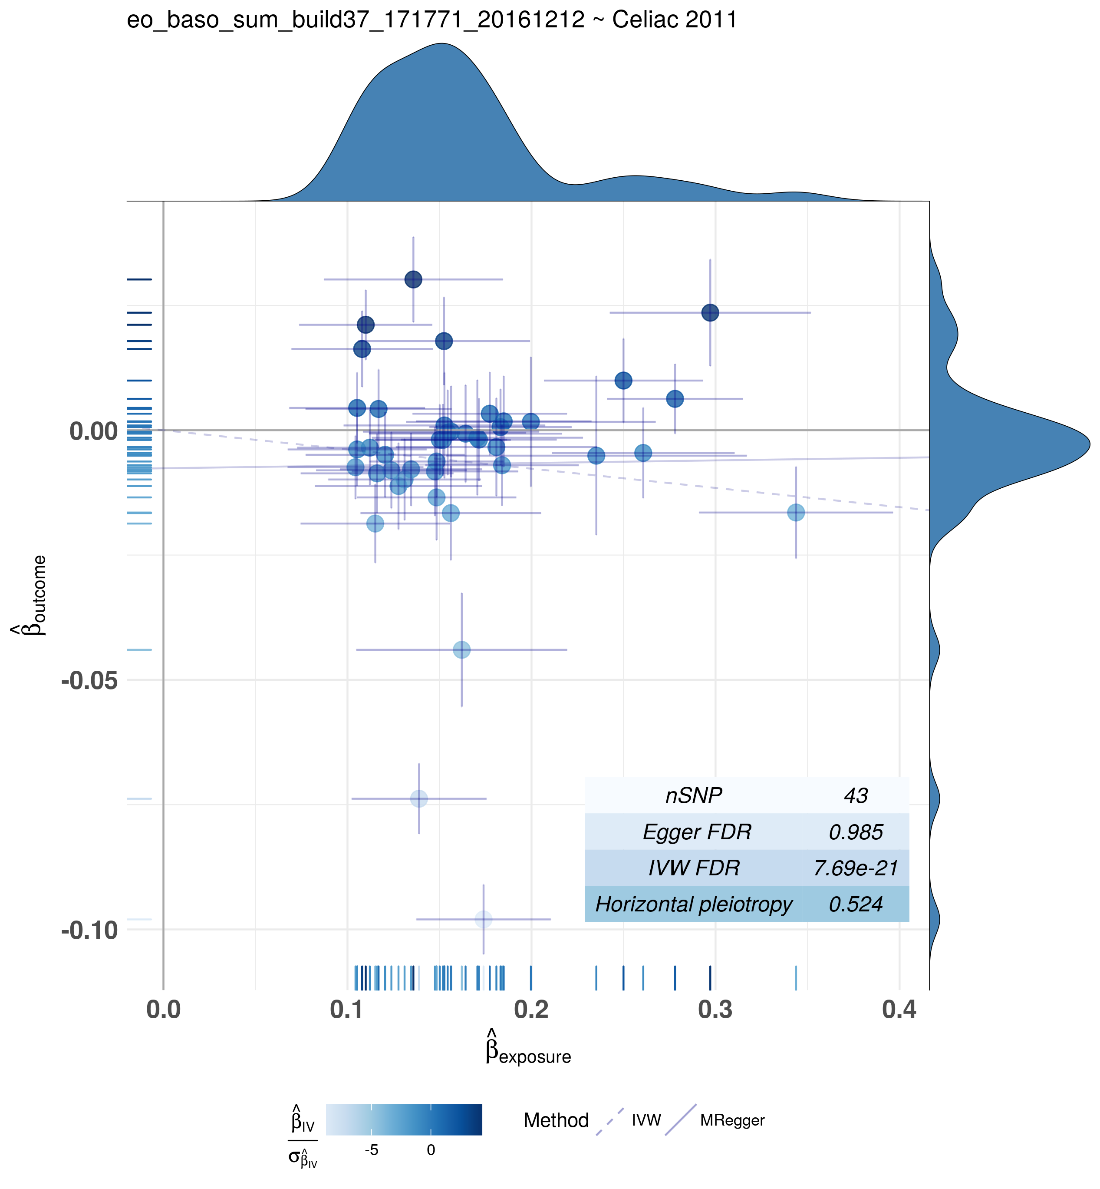
Preliminary results Bidirectional MR
19
Celiac 2011, Gosia Trynka et al.
An increase in 1 SD of celiac is responsible for an Odds ratio of 3.256354 in eosinophils + basophils count.
An increase in 1 SD of eosinophils + basophils counts responsible for an Odds ratio of 0.7140582 in Celiac

Slide 20
Conclusions
20
Celiac 2011
Phenotype | Conslusion
Rheumatoid Arthritis | Low Rheumatoid Arthritis is protective for Celiac Disease
eosinophils + basophils count | High eosinophils + basophils count is protective for Celiac Disease
eosinophils count | High eosinophils count is protective for Celiac Disease
lymphocytes count | Low lymphocytes count is protective for Celiac Disease
plateletcrit | High plateletcrit is protective for Celiac Disease
platelet count | High platelet count is protective for Celiac Disease
eosynophils percentage | No causal relationship
platelets distribution width | Low platelets distribution width protects for Celiac Disease
hematocrit | Low hematocrit is protective for Celiac Disease
hemoglobin | Low hemoglobin is protective for Celiac Disease

Slide 21
Conclusions
21
Celiac 2010
Phenotype | Conslusion
eosinophils count | High eosinophils count protects for Celiac Disease
hematocrit | High hematocrit protects for Celiac Disease
neuthrophils percentage | No causal relationship
eosinophils % granuloctyes | No causal relationship
eosinophils + basophils count | High eosinophils + basophils count protects for Celiac Disease
eosynophils percentage | No causal relationship
Type 1 Diabetes | Low Type 1 Diabetis protects for Celiac Disease
Multiple Sclerosis | Low Multiple Sclerosis protects for Celiac Disease
Packed cell volume | High packed cell volume protects for Celiac Disease
CD39+ Activated CD4 + CD8 - Treg % Parent | Low CD39+ Activated CD4 + CD8 - Treg % Parent protects for Celiac Disease

Slide 22
Future steps
22
Use PreventCD cohort to validate by predicting causal or protective factors identifeid
Pathway analysis on SNPs in significant hits
Network Mendelian Randomization

